Slide 1



Zomato Dashbord
View in Power BI
Last data refresh:
6/2/2024 11:29:40 AM UTC
Downloaded at:
6/2/2024 7:36:20 PM UTC

Slide 2

Index
Notes:
actionButton
No alt text provided

Slide 3
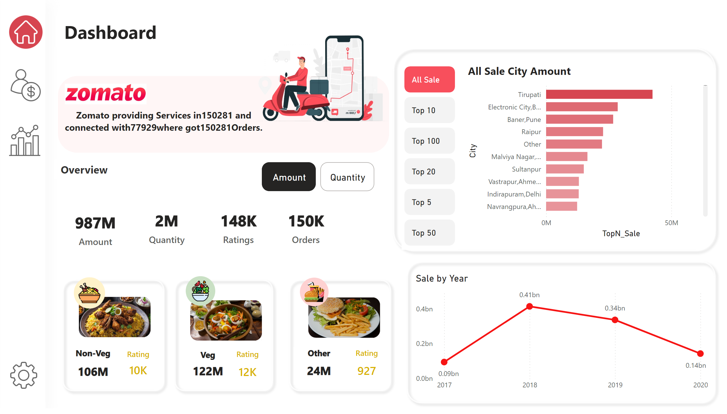
Overview
Notes:
All Sale City Amount
No alt text provided
advancedSlicerVisual
No alt text provided
Sale by Year
No alt text provided
card
No alt text provided
card
No alt text provided
card
No alt text provided
card
No alt text provided
Non-Veg
No alt text provided
Veg
No alt text provided
Other
No alt text provided
Rating
No alt text provided
Rating
No alt text provided
Rating
No alt text provided
advancedSlicerVisual
No alt text provided
shape
No alt text provided
shape
No alt text provided
shape
No alt text provided
shape
No alt text provided
shape
No alt text provided
shape
No alt text provided
image
No alt text provided
image
No alt text provided
image
No alt text provided
image
No alt text provided
image
No alt text provided
image
No alt text provided
image
No alt text provided
image
No alt text provided
image
No alt text provided
image
No alt text provided
textbox
No alt text provided
shape
No alt text provided
textbox
No alt text provided
image
No alt text provided
image
No alt text provided
card
No alt text provided

Slide 4
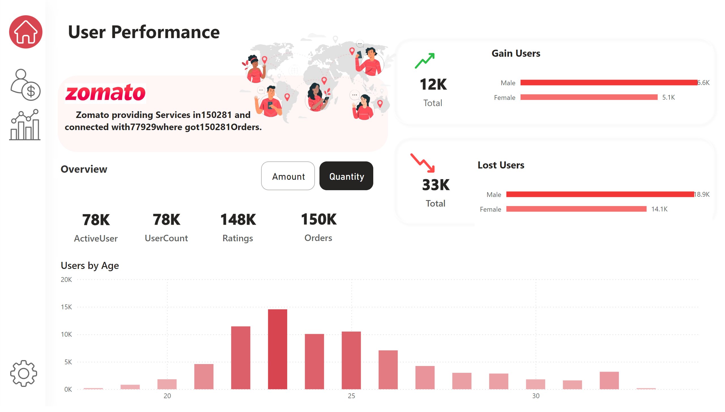
User Performance
Notes:
advancedSlicerVisual
No alt text provided
card
No alt text provided
card
No alt text provided
card
No alt text provided
card
No alt text provided
shape
No alt text provided
image
No alt text provided
image
No alt text provided
textbox
No alt text provided
shape
No alt text provided
textbox
No alt text provided
image
No alt text provided
card
No alt text provided
clusteredColumnChart
No alt text provided
shape
No alt text provided
shape
No alt text provided
Gain Users
No alt text provided
Lost Users
No alt text provided
card
No alt text provided
card
No alt text provided
image
No alt text provided
image
No alt text provided
image
No alt text provided
image
No alt text provided
image
No alt text provided

Slide 5
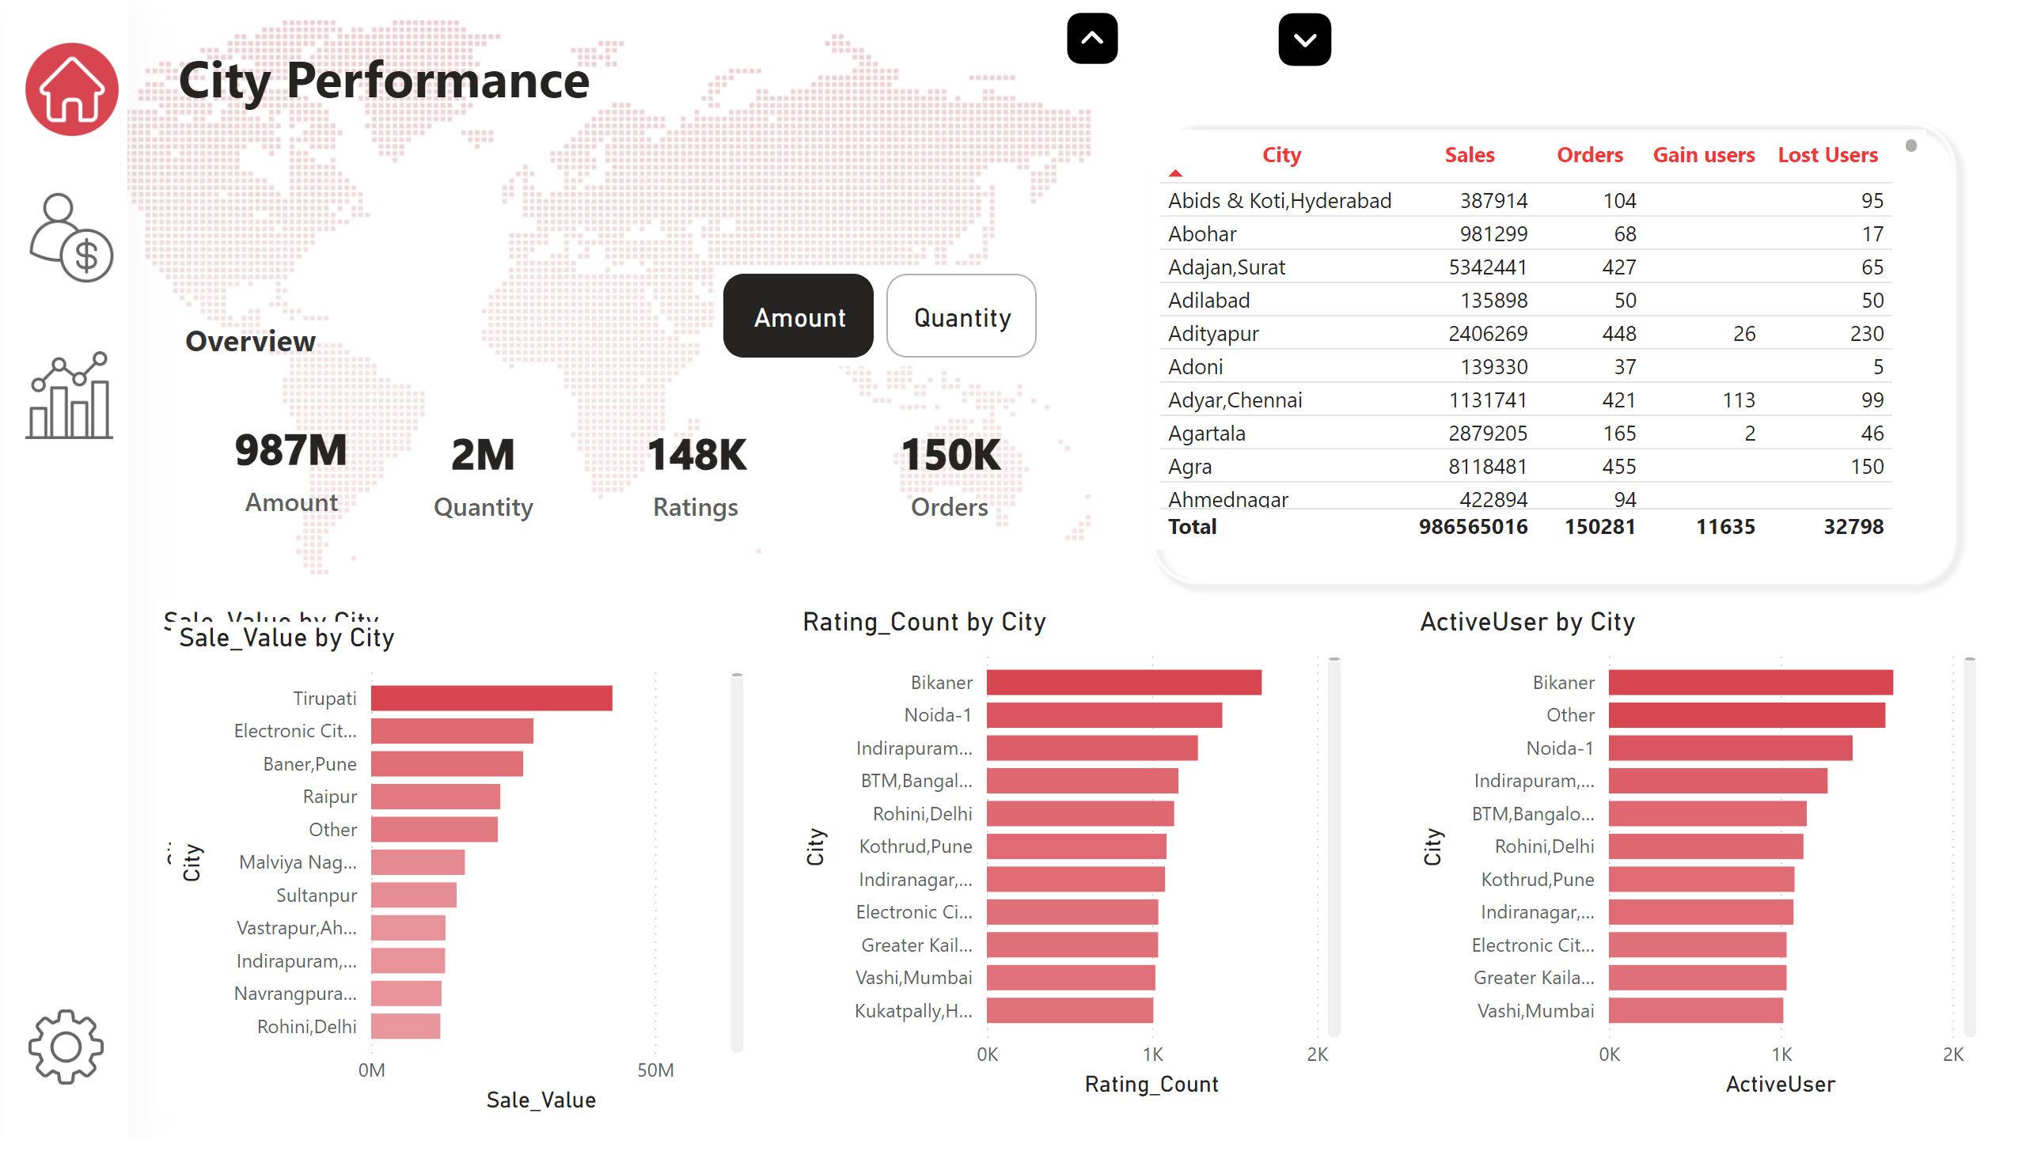
City Performance
Notes:
advancedSlicerVisual
No alt text provided
card
No alt text provided
card
No alt text provided
card
No alt text provided
card
No alt text provided
shape
No alt text provided
shape
No alt text provided
slicer
No alt text provided
slicer
No alt text provided
slicer
No alt text provided
image
No alt text provided
image
No alt text provided
image
No alt text provided
textbox
No alt text provided
textbox
No alt text provided
image
No alt text provided
clusteredBarChart
No alt text provided
clusteredBarChart
No alt text provided
clusteredBarChart
No alt text provided
clusteredBarChart
No alt text provided
tableEx
No alt text provided
image
No alt text provided
image
No alt text provided
shape
No alt text provided
image
No alt text provided

